Slide 1
Slaviša Đurđić
Superstore
Goal: Analysis of the Tableau “Superstore Sales” business sample dataset for period 2014-2017.
Instructions:
- Collect data by downloading the Excel file from https://public.tableau.com/app/learn/sample-data?qt-overview_resources=1#qt-overview_resources.
- Build visuals in Tableau (https://public.tableau.com/app/profile/slavisadurdic/viz/SuperstoreSampleDataset_16935201834720/Dashboard1).
- Run hypothesis testing in Python.
Belgrade, September 2023

Slide 2
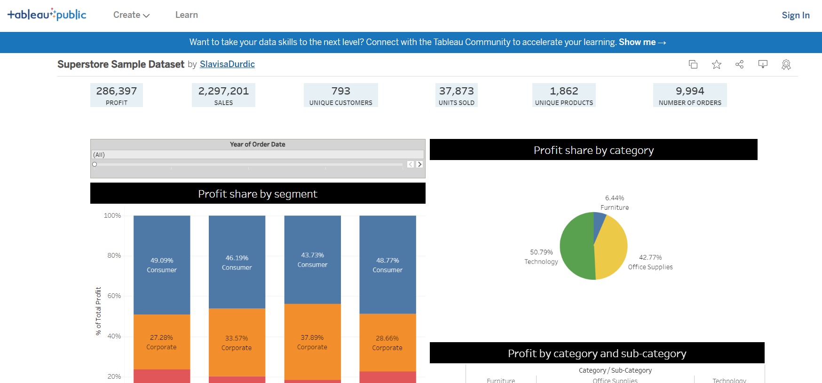

Slide 3

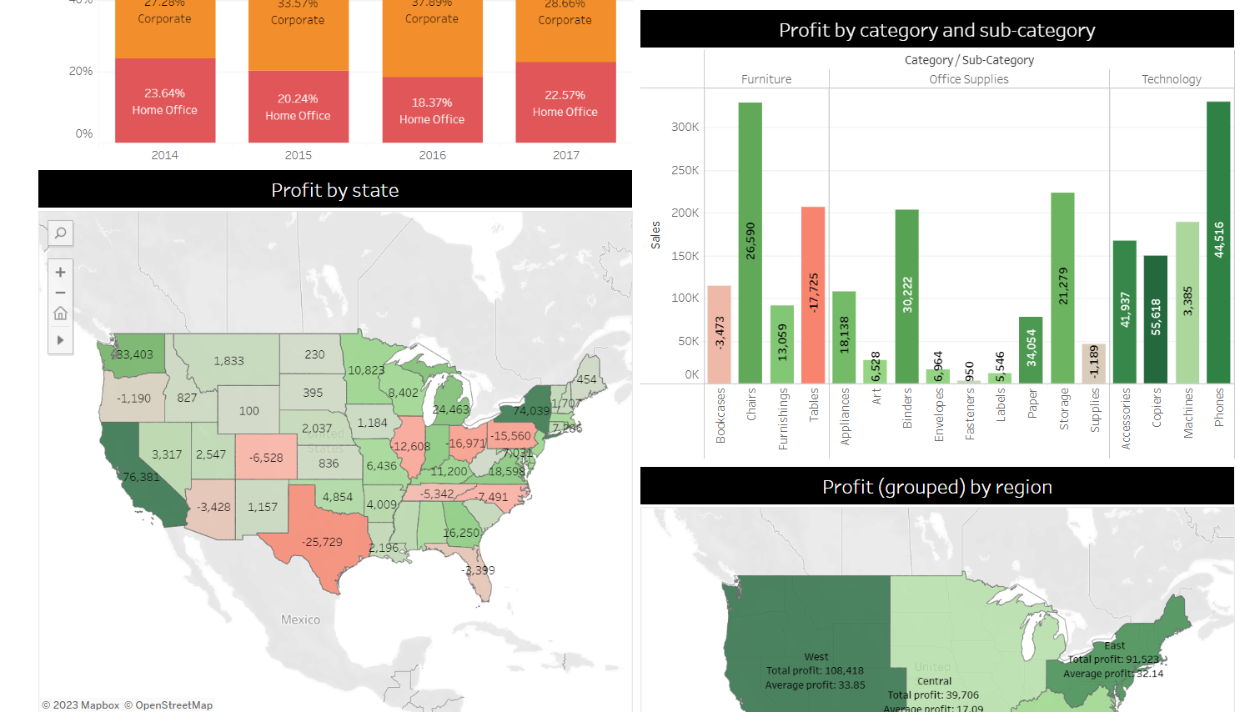

Slide 4
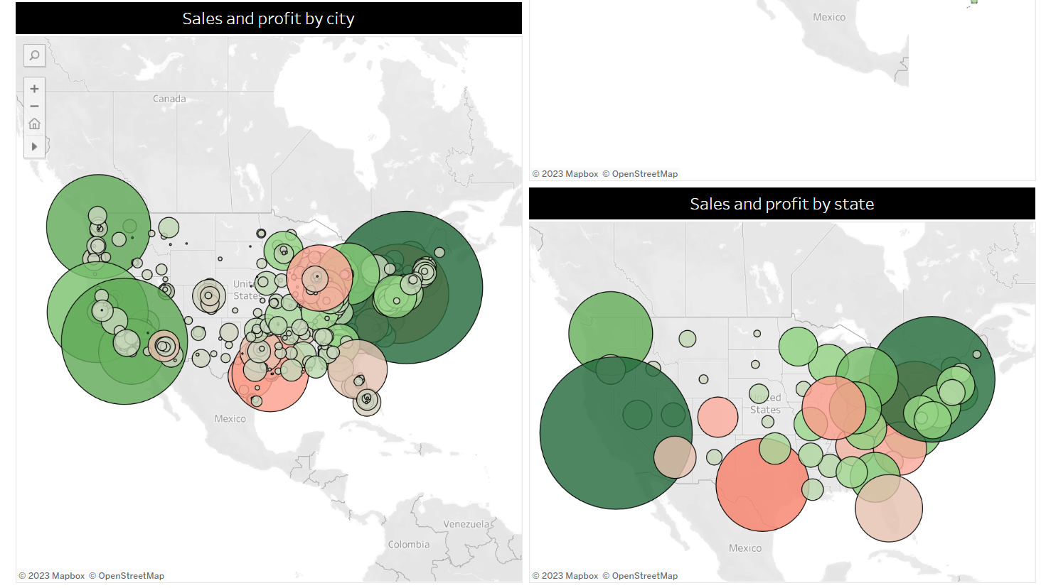

Slide 5
Superstore Project Insights
1) Overall, "Consumer" segment brings the highest profit (around 45% of the total profit).
2) Overall, "Technology" category brings the highest profit (around 50% of the total profit, and it has been increasing over time).
3) California and New York bring the highest sales and profit results, while Texas and Pennsylvania were the two US states with the worst financial results (i.e., financial losses) reported in the given period.
4) Let's take Texas for instance - Although sales amount was one of the best among all states, it seems that negative profit comes from very high cost of goods sold (i.e., furniture COGS). Additionally, "Furniture", as a product category, influenced the most negative financial results.
5) Furthermore, although "Tables" appeared to be a significant revenue item, if we take a closer look at its profitability, we can see that they are least profitable.

